Slide 1
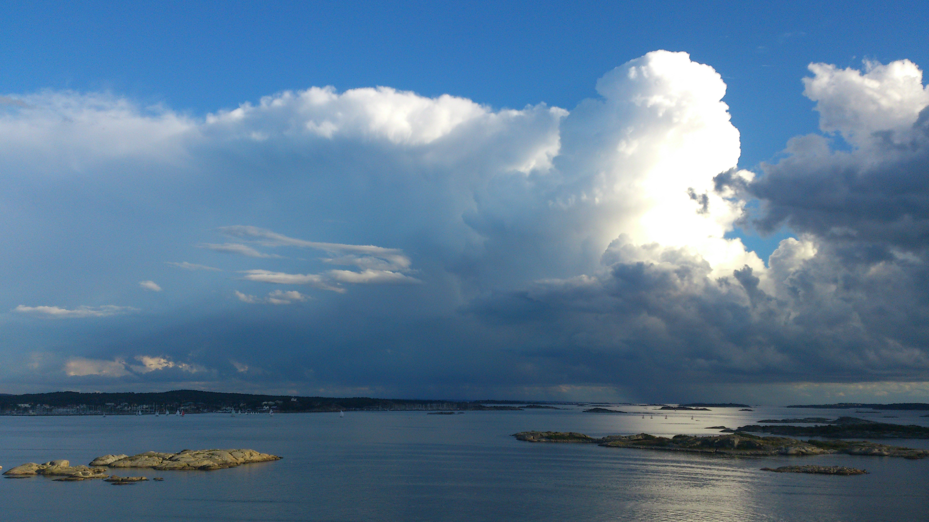
Probabilistic thunderstorm forecasts using Harmonie and ECMWF predictors with logistic regression and machine learning technique(s)
Date: February 2019
By Edward Groot
Supervisors: Maurice Schmeits (KNMI), Kirien Whan (KNMI), Willem Jan van de Berg (IMAU)

Slide 2
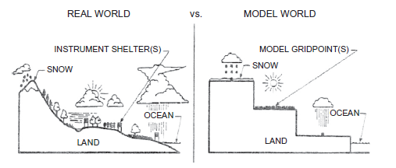
Why post-processing?
Direct model output (DMO) from a numerical weather prediction (NWP) model is biased, because
Model has gridboxes which represent gridbox average conditions
Also: missing physics & chaos in the system
We can correct systematic errors!

Slide 3
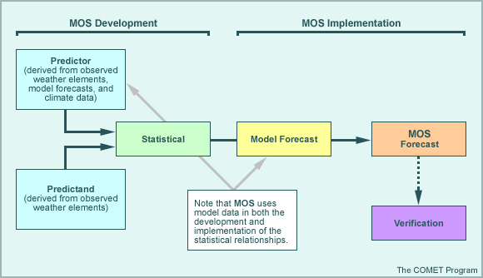
Model Output Statistics (MOS)

Slide 4
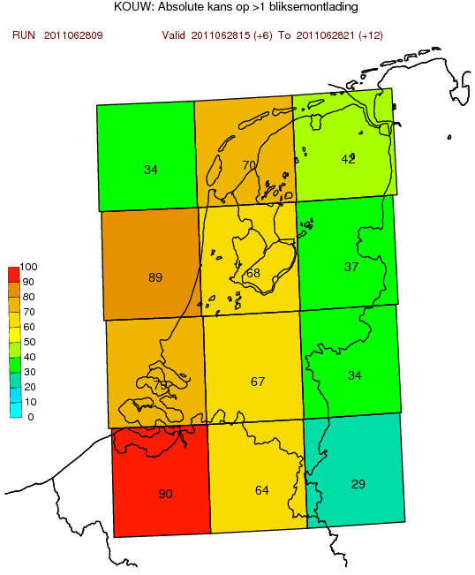
Previously constructed model...
Based on logistic regression and extended logistic regression, shortly (E)LR
Post-processing hirlam (11x11 km) and ECMWF output: both have convection parametrized
Newer Harmonie-model (2.5x2.5 km) solves deep convection

Slide 5
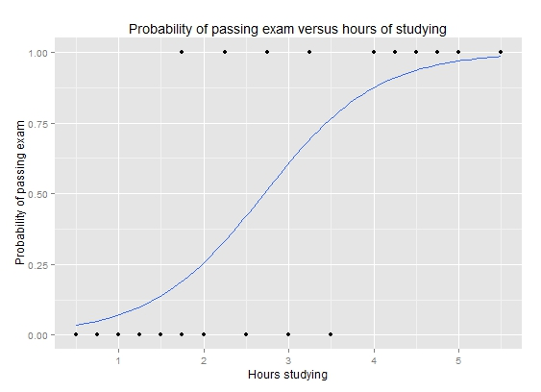
Logistic regression
Logistic transformation of (multivariate) linear regression model
P: probability of event observation
Example: wikipedia

Slide 6
Extended logistic regression
Extension with threshold θ
Results in probability density function
Shift line as function of θ

Slide 7

Quantile regression forest
Simple example tree
Forest of trees
Trees of nodes
Nodes: split observations in two based on predictor
Minimize sum of variance of each of the two sets at each step, or optimize a similar statistical measure (depending on type of data)
X₁ > 10
Y:
X₂ > 5
N:
X₃ > 2
Y:
X₁ > 3
Y:
X₄ > 8

Slide 8
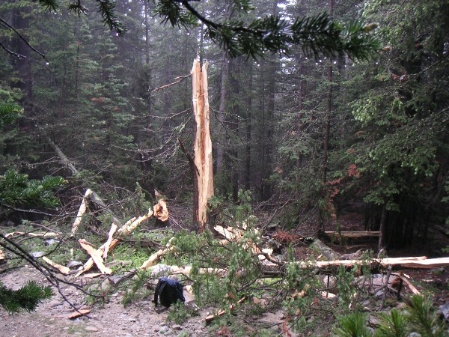
Quantile regression forest
Random selection of dataset for each tree
Random selection of potential predictors for each node
=> trees (n = 500) that group similar records
=> probability density function based on “near neighbours” in selected predictors
Picture: canada.ca

Slide 9
Hyperparameters
For each model type, number of predictors is a so-called hyperparameter
Many hyperparameters for QRF: number of trees, number of observations in final split

Slide 10
Model evaluation & selection
Cross-validating: training on 2 years with 3 random subsets
12 KOUW regions
Train again with best hyperparameter combination based on scores in initial cross-validation => do final cross validation

Slide 11
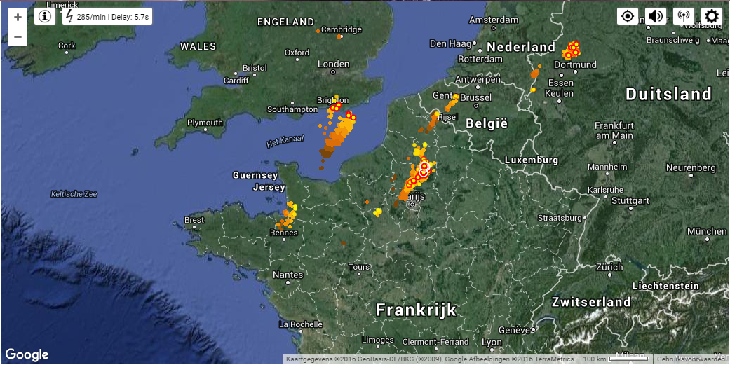
Predictand
1. Occurrence of 2 or more lightning discharges within a KOUW region, “thunderstorm event” (previous slide)
2. Maximum intensity within region, number of discharges / 5 min
Based on “KLDN detections” (as “truth”)
Any lightning detection dataset is not 100% accurate
Example of detections by lightning
detection system

Slide 12
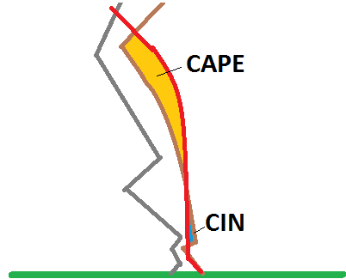
Predictor variables
Varies from humidity, temperature and wind speed (DMO) to derived quantities
To some well-known derived predictors
level of neutral buoyancy (LNB)
level of free convection (LFC)
(figure CAPE)

Slide 13
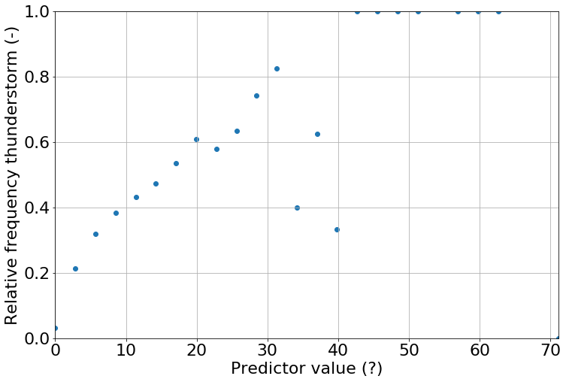
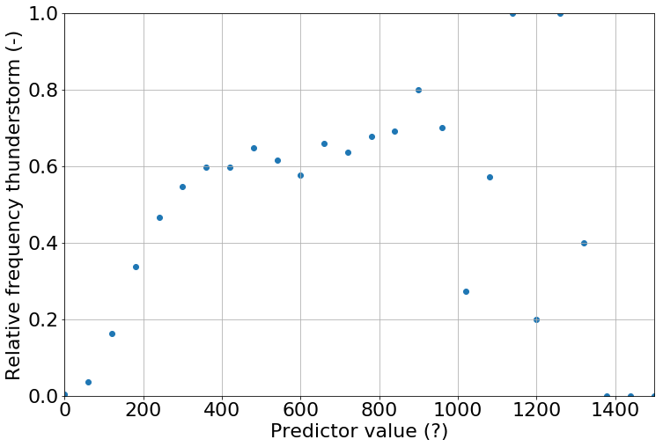
Predictor variables
Some single predictors (all lead times) related to thunderstorm rel. frequency
Harmonie max. hourly conv. Precip. (mm)
Most Unstable CAPE max (entrainment corr.)

Slide 14

Predictor selection
Dozens of variables
Best are selected
Stepwise selection and/or
elimination
clipart.com

Slide 15
Aim
Increase physical understanding and forecasting of thunderstorms in NL (and interrelation between the two)
Compare statistical post-processing methods for thunderstorms/severe convection
Make an operational post-processing model for weather forecasting

Slide 16
Physical context
What information give predictors in types of cases (e.g. land/sea temperature contrast/triggers/instability) and between lead times and valid times
And skill statistical optima vs. physical consistency?
Which instability indices and which dynamical quantities (and when)?

Slide 17
Questions?

Slide 18
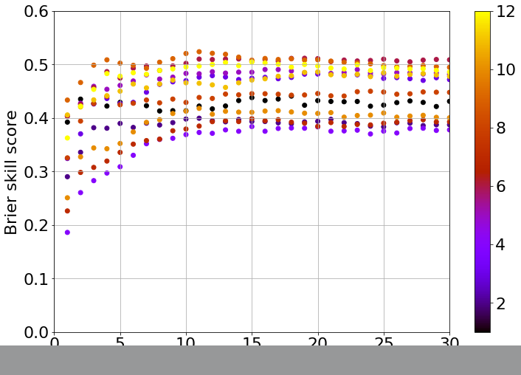
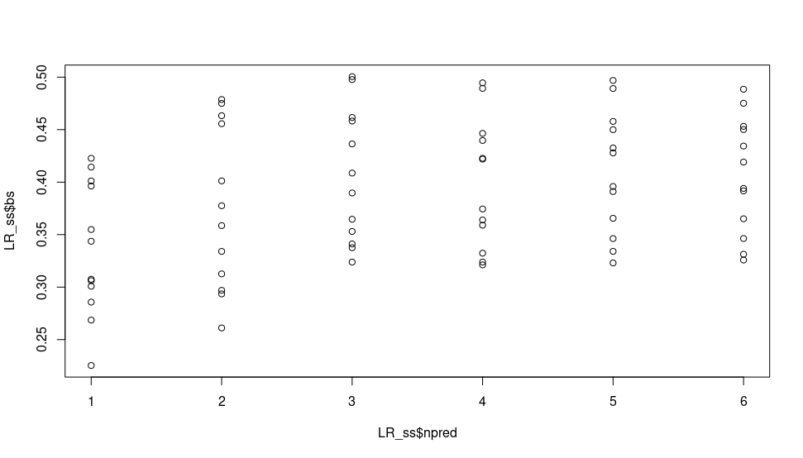
Extra slides
Preliminary results: thunderstorm yes/no
QRF: 9-fold cross (for hyperpar. selection)
LR: 9-fold cross (for hyperpar. selection)

Slide 19
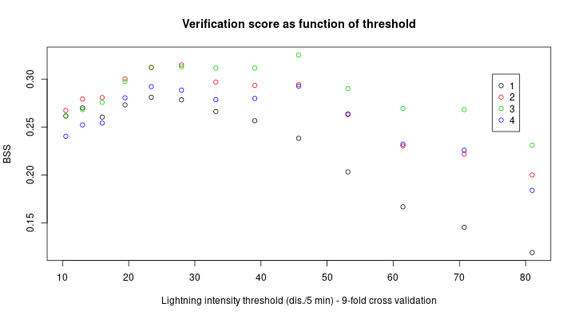
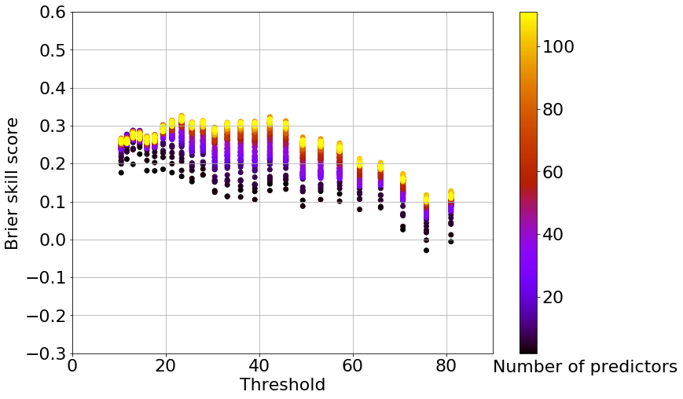
Extra slides
Preliminary results: thunderstorm thresholds
ELR: 9-fold cross (color: no. of pred.)
Evening & shortest lead time
QRF: 9-fold cross (for best hyperpar. set)
Evening & shortest lead time

Slide 20
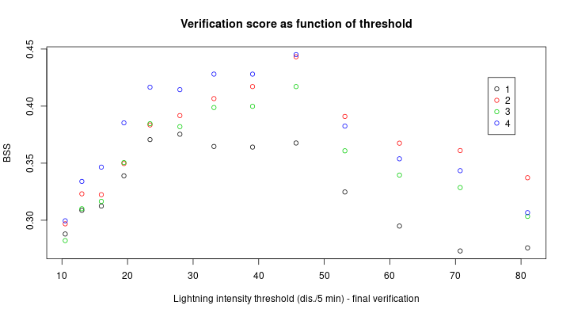
Extra slides
Preliminary results: thunderstorm thresholds
ELR: 9-fold cross (color: no. of pred.)
Evening & shortest lead time
ELR: final cross validation (color: no. of pred.)
Evening & shortest lead time
But: inconsistent predictor set

Slide 21
Thunderstorm climatology

Slide 22
Climatology 2015-2017
Following results are based on the full year, so including winter statistics

Slide 23
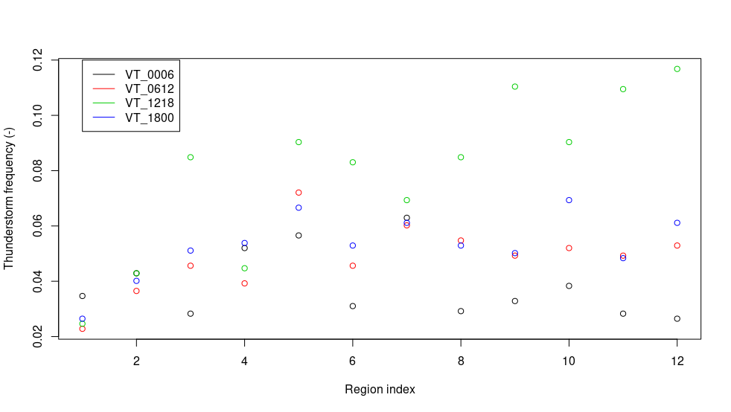
2 points

Slide 24
Climatology 2015-2017
Occurrence at least 2 dis. irrespective of region:
3.8% at night, 7.9% during afternoon (all year!)
5.4% over all VT combined
About 10% more with 1 dis.
About 9% less if > 2 dis.
About 15% less if > 3 dis.

Slide 25
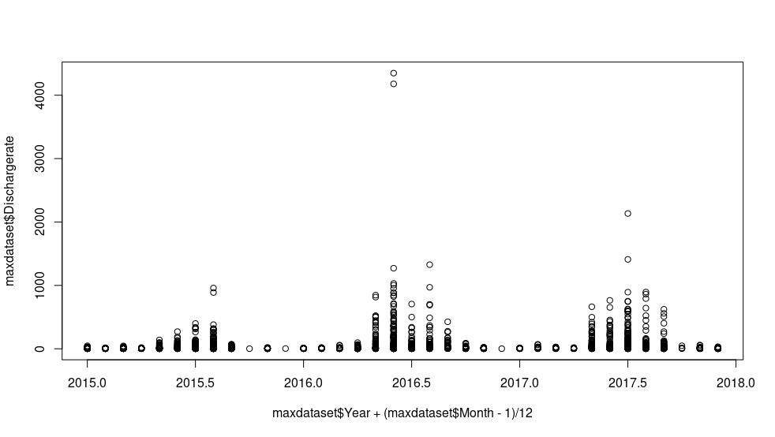
Q0.98:
2015 → 29
2016 → 91
2017 → 86
Dis./region/6hours
At least 2 dis.
2015 → 4.5%
2016 → 5.9%
2017 → 5.6%

Slide 26
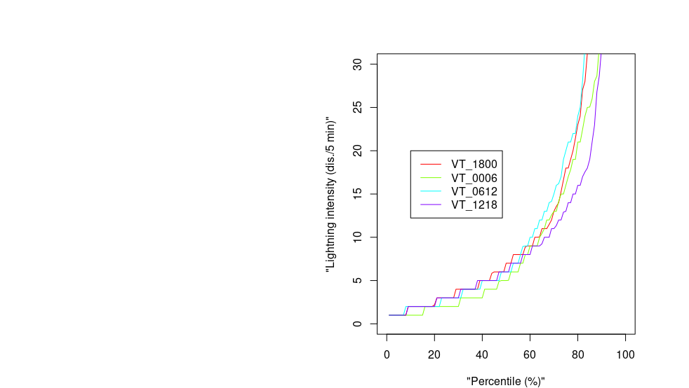
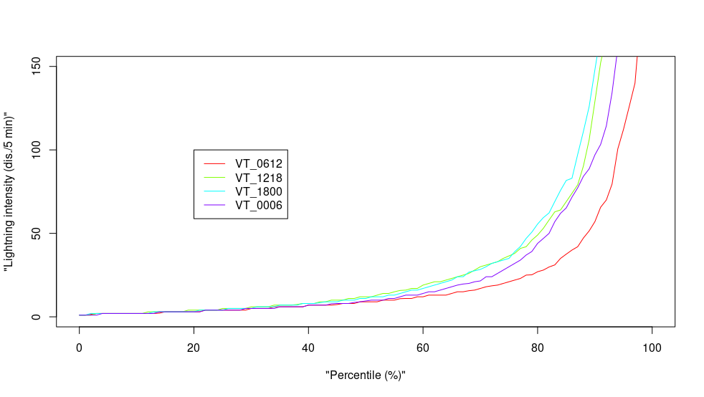
Note: line colors incompatible

Slide 27
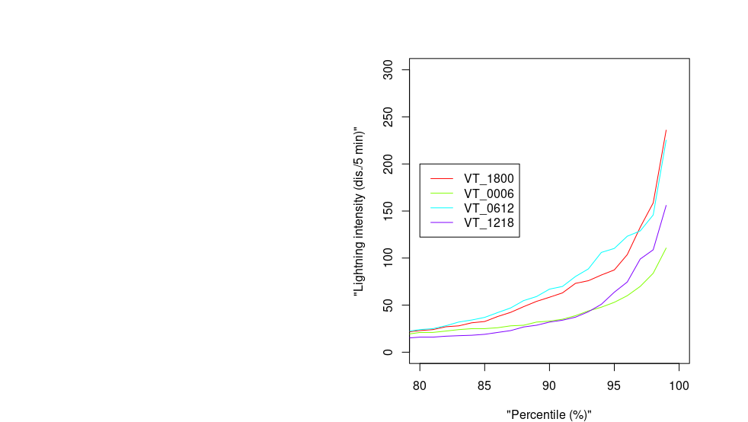
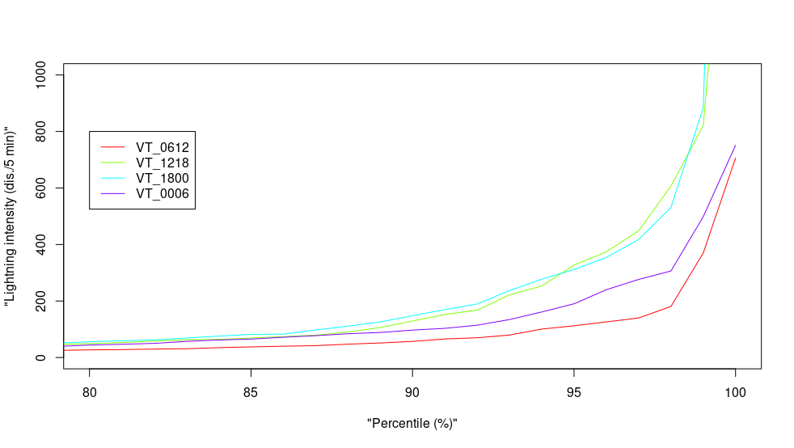
Note: line colors incompatible

Slide 28
Climatology 2015-2017 vs. 2010-2013
Total no. of discharges all year
2015 → 202.548*
2016 → 712.593
2017 → 455.085
2013 → 80.391
2011 → 96.606
2010 → 52.165
* some missing values on december 1st: 48x “99999”

